Slide 1

Happyness
By TheHappyCo

Slide 2
Team Intro

Slide 3
The WHY
Motivation behind the topic

Slide 4
The How – Data Exploration
Sourcing
Google
Seeing the CSV
Pandas
Selection
Choosing the dataset
Kaggle
Eye-balling
Cleaning up the dataset

Slide 5
The How – Data Exploration
How we identified what’s relevant
How we sourced it
How we pivot?

Slide 6
Analysis – Heat Map
Chart 1
- High scores over world

Slide 7
Null Hypothesis
Happyness
The Longer one lives
The greater purchasing power one has
The More the merrier
The freedom and security

Slide 8
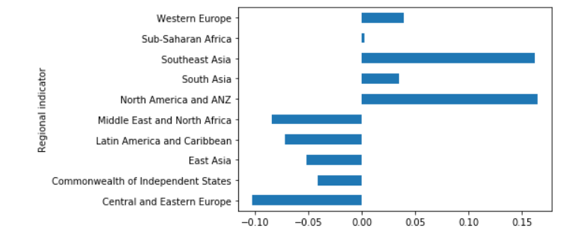
The not-null Hypothesis

Slide 9
Analysis – Correlation
Chart
- Happiness score vs life expectancy

Slide 10
Analysis 2 - Correlation
Question 2
Chart 2b
Happiness score vs medicare?

Slide 11
Analysis - Correlation
Question
Chart
Happiness score vs alcohol consumption?

Slide 12
Analysis 3 – Linear Regression 2
Question 3
Chart 3a

Slide 13
Analysis 3
Question 3
Chart 3b

Slide 14
Analysis 4 – Groupby, Ranking?
Question 4
Chart 4a

Slide 15
Analysis 4
Question 4
Chart 4b

Slide 16
Summary

